Slide 1


Dasturiy ta’minot yaratish metodologiyasi
Kod yozishdan oldin
IT CREATIVE

Slide 2

Talablarni aniqlash
WATERFALL MODEL
Reja/
Dizayn
Kodlash
Sinovdan o’tkazish Test
Deploy
Hosting
Texnik xizmat ko’rsatish
IT Creative

Slide 3

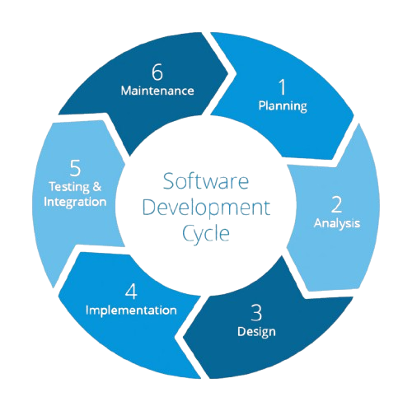
Agila Model
IT Creative

Slide 4
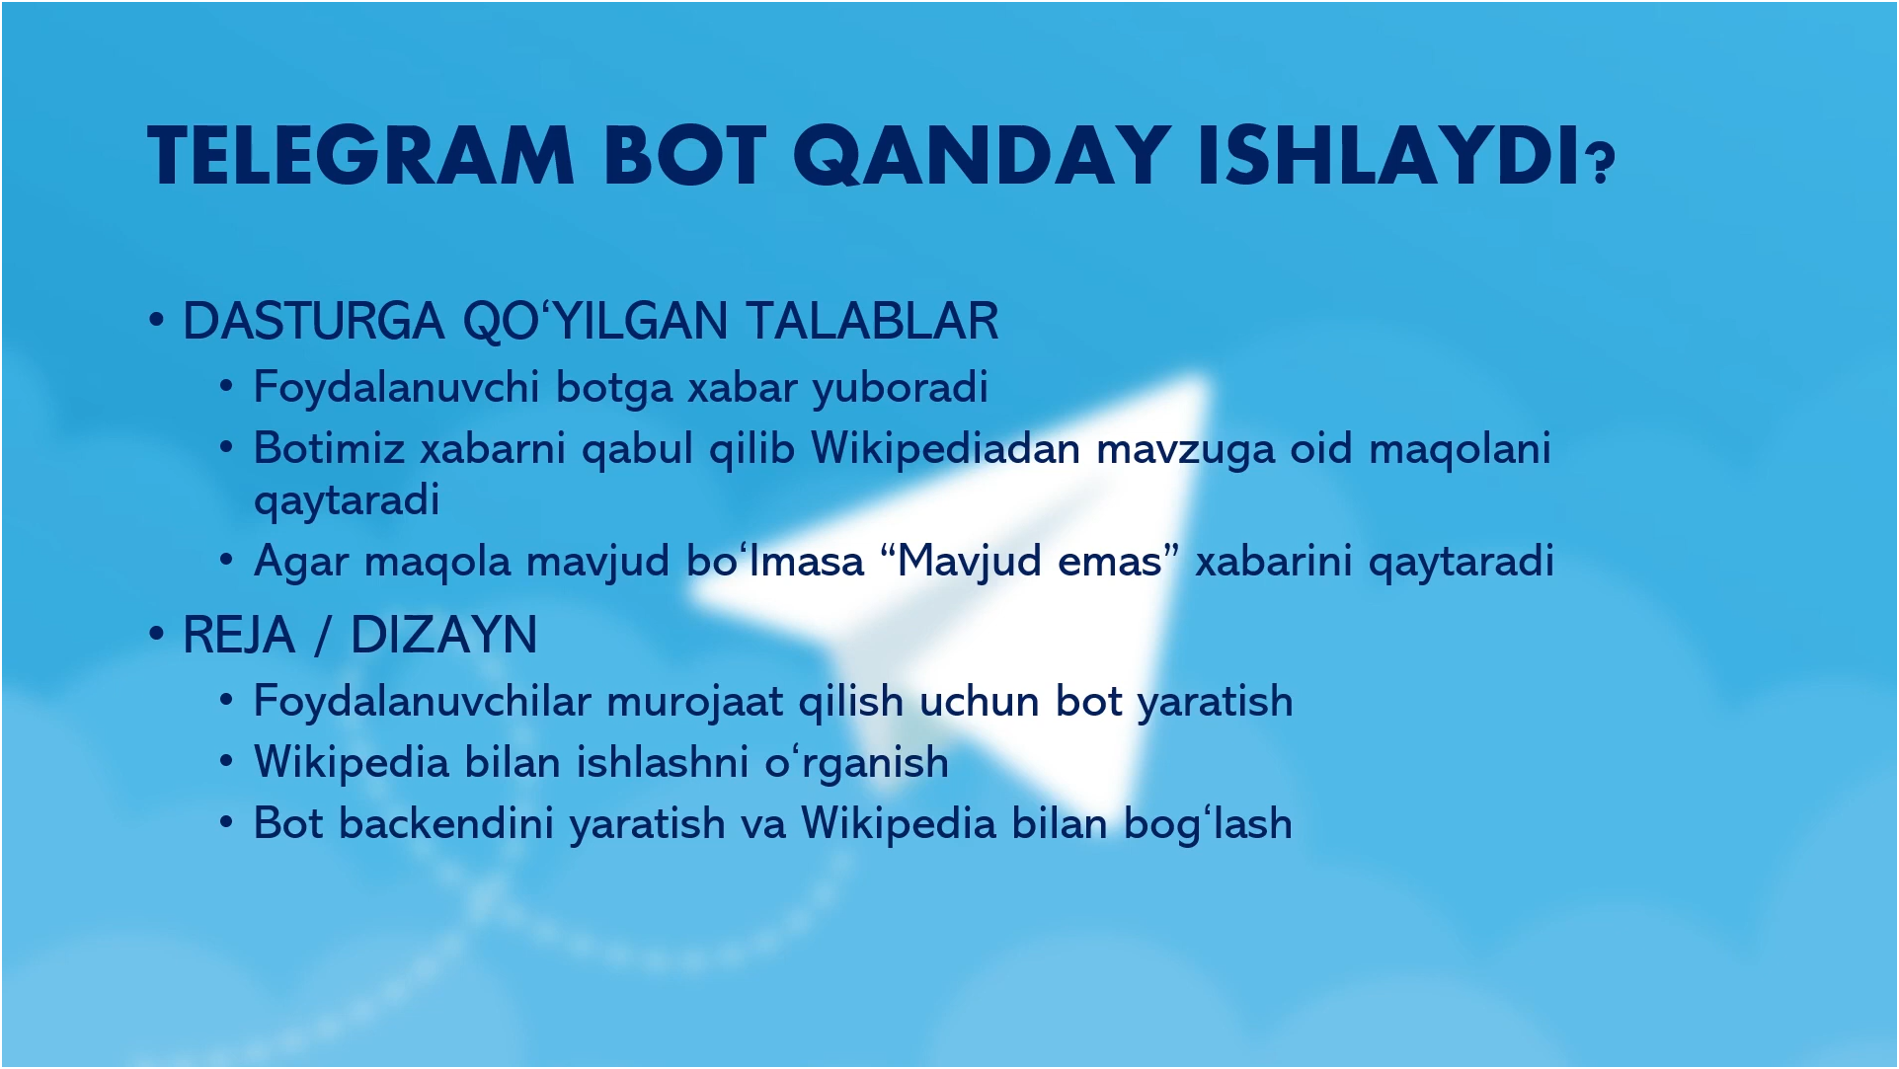
IT Creative

